Slide 1
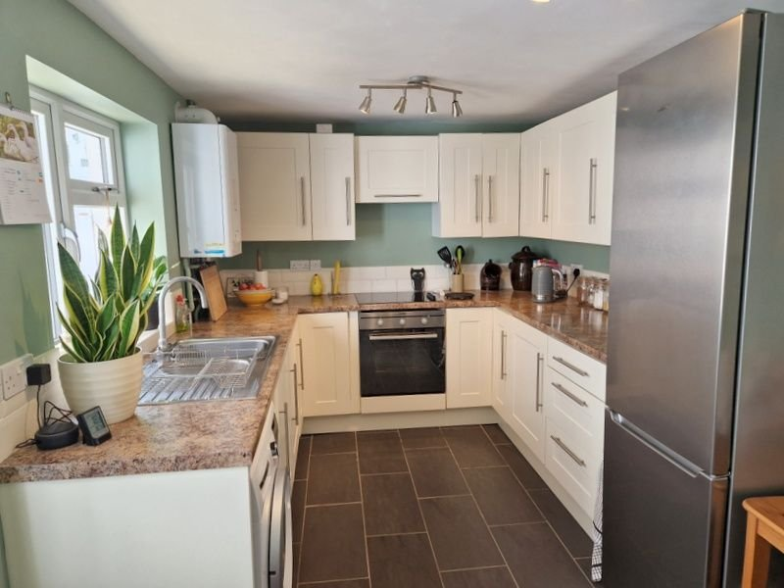
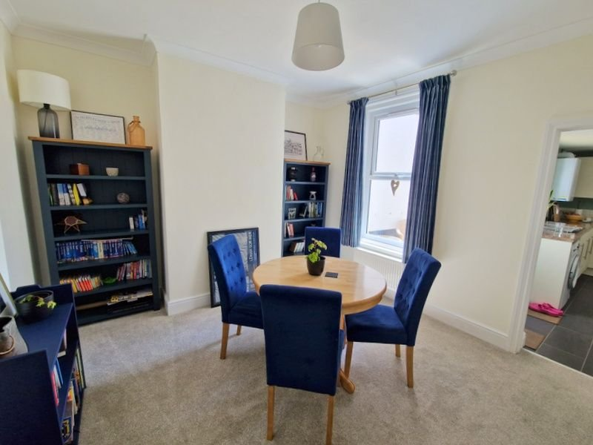
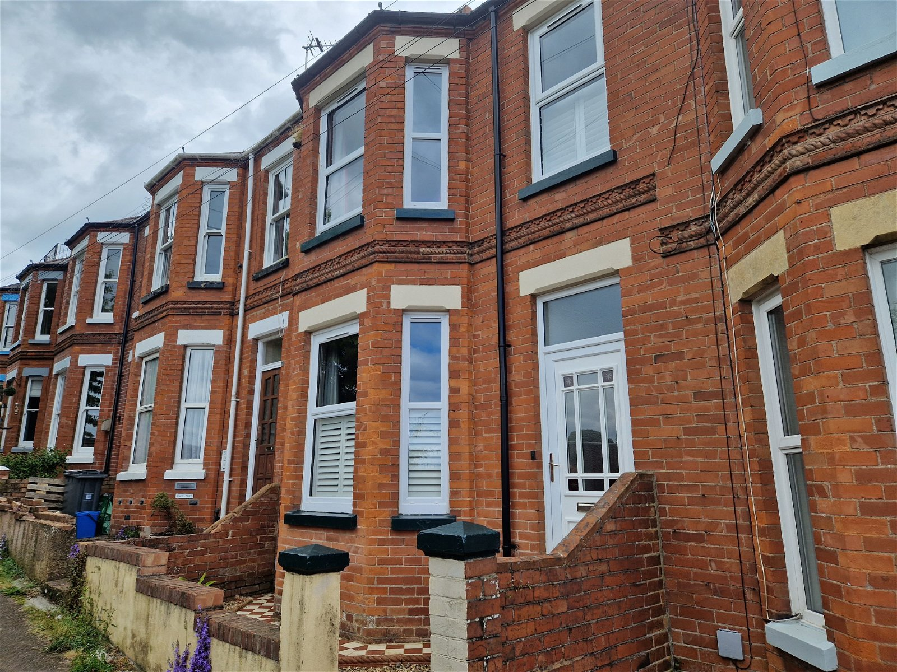
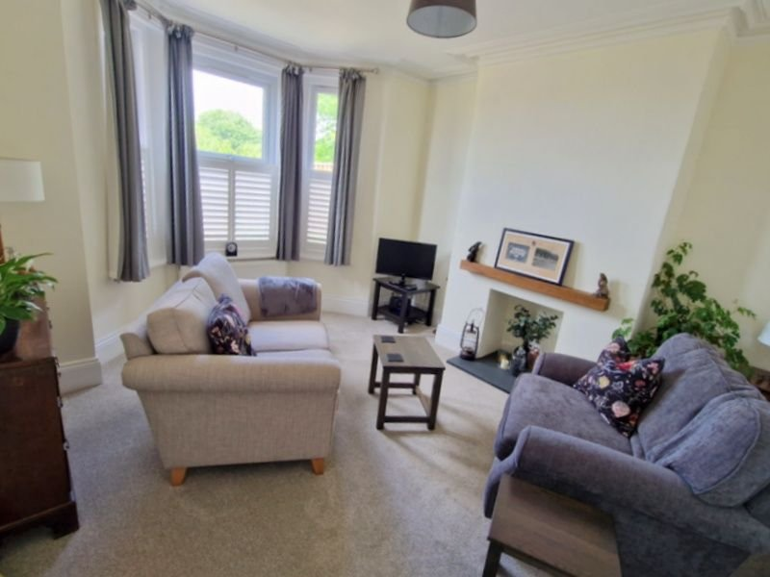
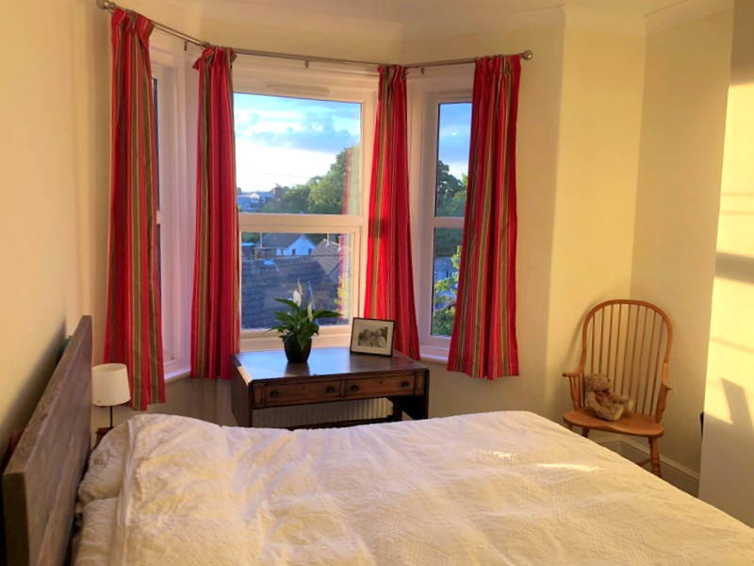
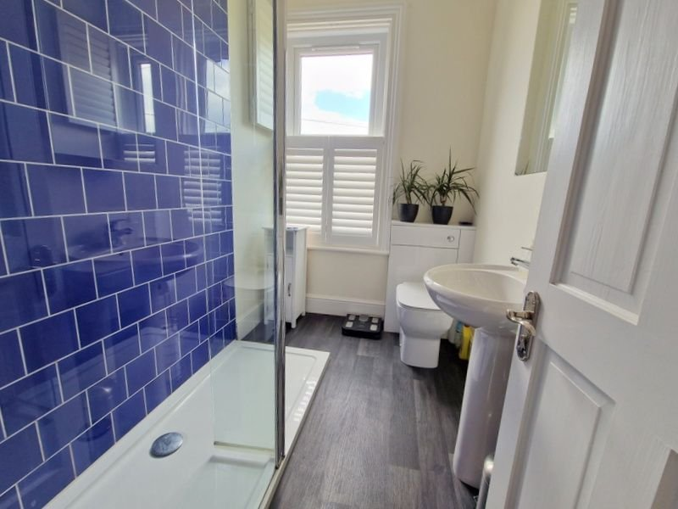
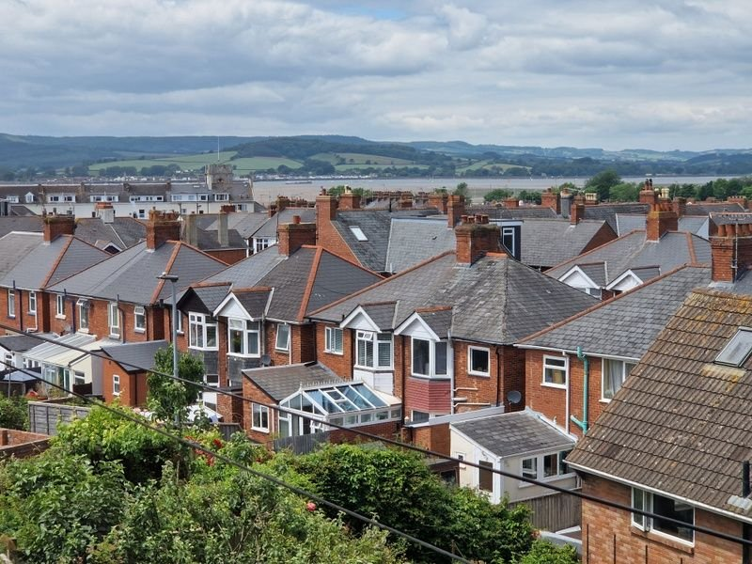
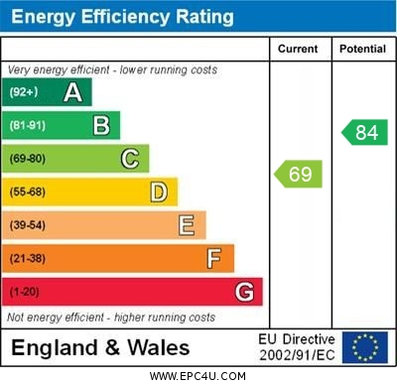
www.pennys.net
11 Fairview Terrace, Exmouth, EX8 2JX
GUIDE PRICE £395,000
TENURE Freehold
Superbly Presented And Much Improved Bay Fronted Terrace House Enjoying Quiet Tucked Away Yet Central Location With Wonderful Estuary And Coastal Views And Parking Bay For Two Cars
Entrance Vestibule * Reception Hall * Lounge * Dining Room * Modern Kitchen * Three First Floor Double Bedrooms * Stylish Modern Shower Room/WC * Cloakroom/WC * Gas Central Heating Via Modern Boiler * uPVC Double Glazed Windows * South Facing Rear Patio * Viewing Strongly Recommended * No Onward Chain
Pennys Estate Agents Limited for themselves and for the vendor of this property whose agents they are give notice that:- (1) These particulars do not constitute any part of an offer or a contract. (2) All statements contained in these particulars are made without responsibility on the part of Pennys Estate Agents Limited. (3) None of the statements contained in these particulars are to be relied upon as a statement or representation of fact. (4) Any intending purchaser must satisfy himself/herself by inspection or otherwise as to the correctness of each of the statements contained in these particulars. (5) The vendor does not make or give and neither do Pennys Estate Agents Limited nor any person in their employment has any authority to make or give any representation or warranty whatever in relation to this property.
PENNYS ESTATE AGENTS
2 Rolle House, Rolle Street, Exmouth, Devon, EX8 2SN
Tel: 01395 264111 EMail: help@pennys.net

Slide 2
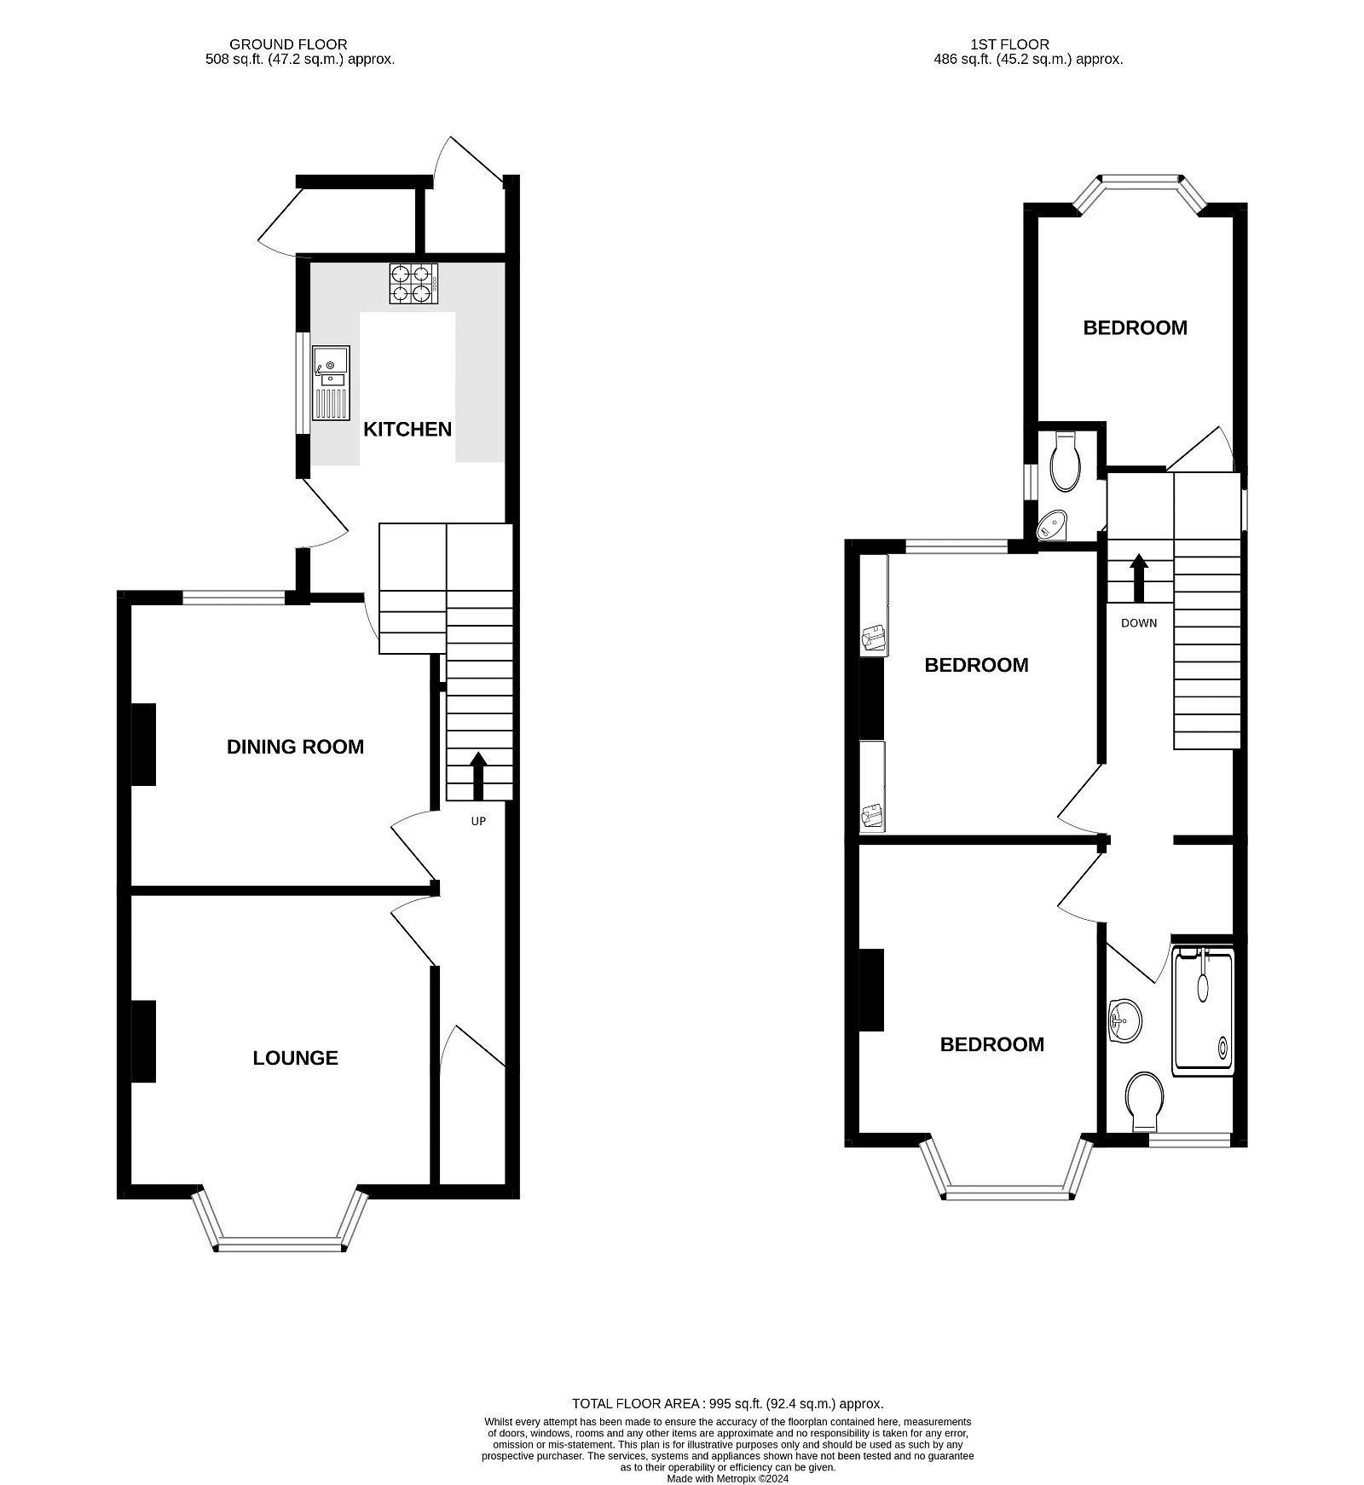
11 Fairview Terrace, Exmouth, EX8 2JX
Pennys are delighted to offer for sale this wonderful example of a period terrace house which has been much improved over recent years by the present owner and now provides a lovely home in a central yet tucked away location with parking for two cars. The accommodation has modern roof covering and central heating system, enjoys two reception rooms, a fitted kitchen, three double bedrooms and stylish shower room/WC and separate cloakroom with WC also on the first floor. From the front elevation windows there is excellent views across the town to the estuary and coastline in the distance. Viewing is strongly recommended.
THE ACCOMMODATION COMPRISES: uPVC double glazed front door with patterned glass window inset to:
ENTRANCE VESTIBULE: Feature mosaic tiled floor, inner solid wood door with stained glass window inset giving access to:
RECEPTION HALL: With radiator, ornate ceiling arch, staircase rising to first floor landing.
LOUNGE: 4.42m x 3.78m (14'6" x 12'5") A charming room with measurement into uPVC double glazed bay window to the front aspect, fitted with wooden window shutters, chimney recess with slate hearth and wood beam over, TV point, radiator.
DINING ROOM: 3.81m x 3.56m (12'6" x 11'8") With uPVC double glazed window to rear aspect, radiator, door to:
KITCHEN: 4.17m x 2.51m (13'8" x 8'3") Modern kitchen fitted with a range of patterned gloss finished worktops with tiled surrounds, with range of cupboards, drawer units, plumbing for automatic washing machine, inset one and a half bowl single drainer sink unit with mixer tap, built-in oven with ceramic hob over and filter extractor fan, wall mounted cupboards, space for upright fridge/freezer, access to good size understairs storage cupboard, radiator, wall mounted Glow Worm gas boiler for hot water and central heating, uPVC double glazed window and uPVC double glazed door giving access to the rear garden.
FIRST FLOOR LANDING: With double glazed window with patterned glass, large access with pull down ladder to loft space (this area could offer potential to be converted into additional accommodation subject to the necessary consents), radiator.
BEDROOM 1: 4.47m x 3.15m (14'8" x 10'4") Measurement into uPVC double glazed bay window which overlooks the front elevation and gains wonderful estuary and coastline views, radiator.
BEDROOM 2: 3.53m x 2.69m (11'7" x 8'10") With built-in wardrobes in wall recesses with drawer units beneath, radiator, uPVC double glazed window to rear aspect.
BEDROOM 3: 3.91m x 2.62m (12'10" x 8'7") Measurement to uPVC double glazed bay window to rear aspect, radiator.
SHOWER ROOM/WC: 2.44m x 1.65m (8'0" x 5'5") Stylishly fitted with a double width ease of access shower tray, chrome shower unit with rainfall shower head hose and detachable shower head hose and shower splash screen, attractive tiling to splashback areas, pedestal wash hand basin with mirror fronted medicine cabinet over, WC with concealed cistern with push button flush with display surface over, chrome heated towel rail, recessed ceiling LED spotlighting, uPVC double glazed window with wooden window shutters and gaining excellent estuary and coastline views.
CLOAKROOM/WC: Fitted with corner wash hand basin with tiled splashback with push button flush, uPVC double glazed window.
OUTSIDE: To the front of the property there is a decorative stone garden enclosure with tiled pathway to front door. To the rear of the property there is a sunny aspect patio area with outside light and access to two outside storage cupboards, double width parking bay with vehicular access from wide service lane from Ryll Grove.
AGENTS NOTE: The residents of Fairview Terrace have the benefit of use of a community garden located opposite the terrace which is a fantastic meeting place with seating areas and productive vegetable gardens.
FLOOR PLAN:

